Slide 1
Capstone ETL Process Manager
by Kenneth Copas

Slide 2

Professional Summary
:)
Before Apprenticeship
Software Engineering (JavaScript, HTML, CSS, Java, Python)
Object-Oriented Programming, Dynamic Programming
During Apprenticeship
After Apprenticeship
Courses and Certifications
Data Engineering processes
Database Management, Data Analysis & Visualization
Learned Agile Methodology
Developing skillsets related to Data Engineering (Database Management, Data Processing)
Kenny Copas
Jr. Data Engineer
PeopleShores PBC
Tampa, FL
linkedin.com/in/kennycopas

Slide 3




What problem is being solved?
Raw file data
Improperly Formatted
Local
Inaccessible
Accessible to Programmers
Non-visual
Difficult to Analyze
Not Presentable

Slide 4
Project Overview
ETL Pipeline
Command Line Interface
Formats file data
Stores non-locally
Raw file data
Analysis & Visualization
User-friendly
Makes data accessible
Inaccessible
Tells a story
Makes data Presentable
Non-visual

Slide 5
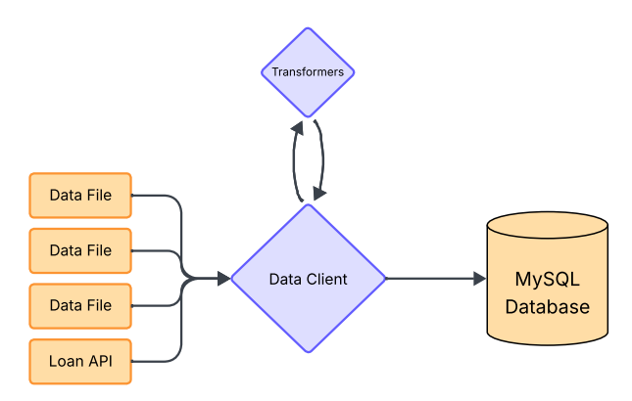
ETL Pipeline
Data Client
Manages ETL Process
Handles Database Queries
Transformers
Contains file-specific transformer functions
Handles transformer mapping
Transform
Extract
Load

Slide 6
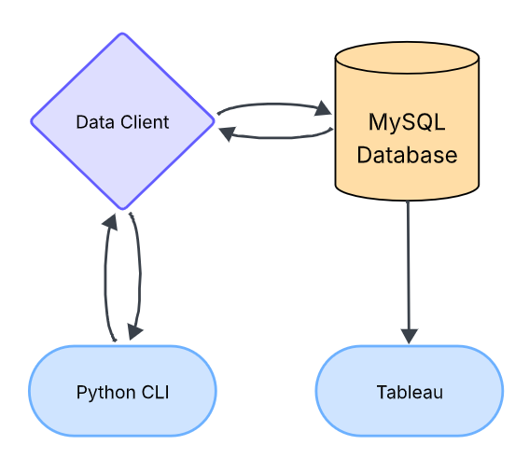
Command Line Interface
Query
Python CLI
User-friendly database interaction
Sends database queries to Data Client
Data Client
Handles database query requests from CLI
Sends database response to CLI
Data
Request
Response

Slide 7
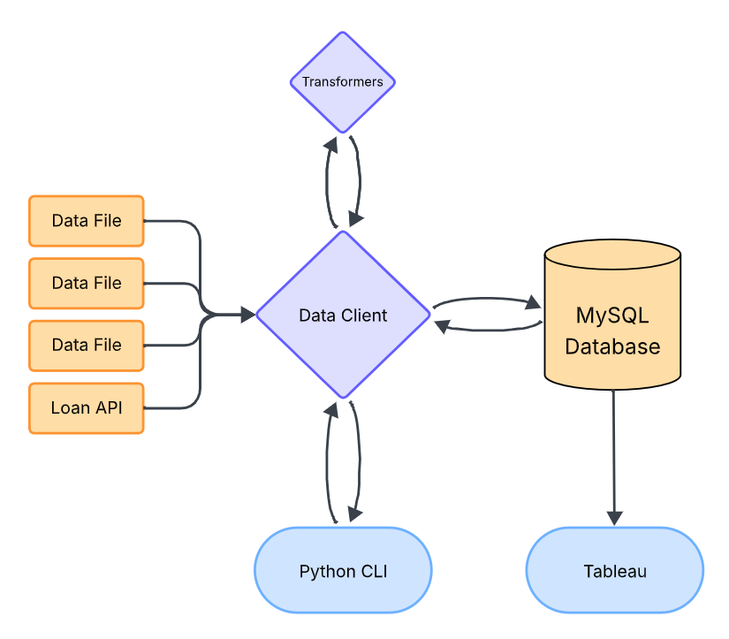
Application Workflow
Central Component
Data Client
Database
MySQL
Frontend
Python CLI
Visualization
Tableau

Slide 8
Development Process
Data Migration Setup
Data Client
Command Line Interface
Application

Slide 9





Tech Stack Overview
Database | Data Processing | Application | Visualization

Slide 10
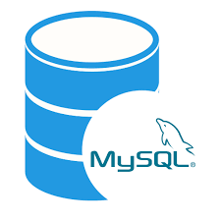
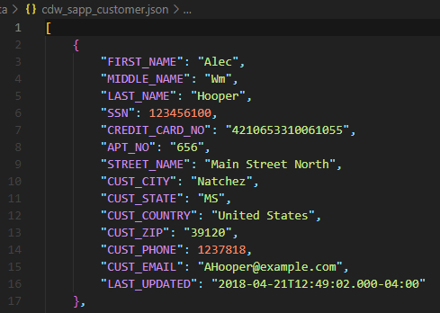
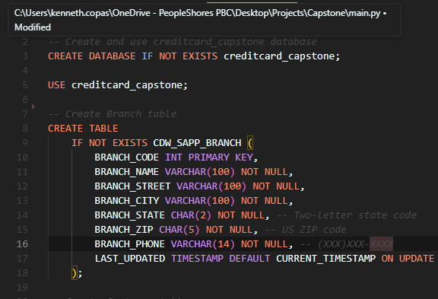
Data Migration Setup
MySQL - Database
cdw_sapp_customer.json - Data
init.sql - Script
MySQL – Database?
Unformatted
Unsorted
Cannot be loaded into database
Initializes Database
Creates Tables
Specifies Schema

Slide 11
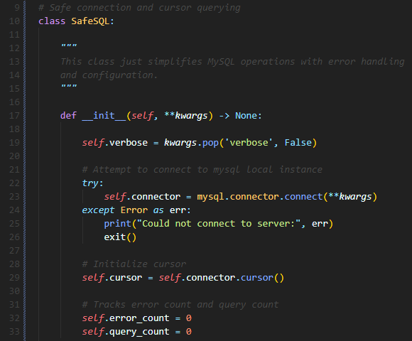
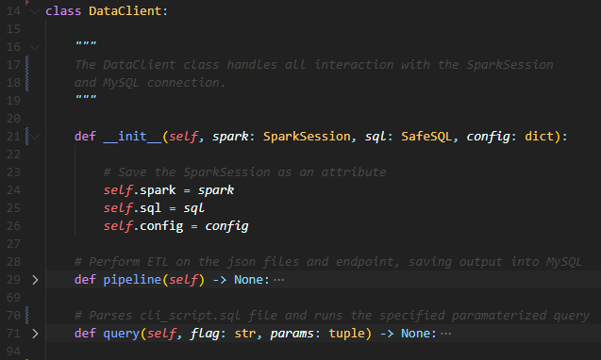
Data Client
sql.py - Utility
data_client.py - Component
General-Purpose
Database Interaction
Error Handling
Application-Specific
Manages ETL Process
Utilizes MySQL and PySpark connections

Slide 12
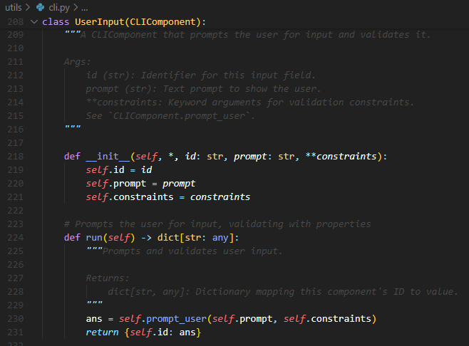
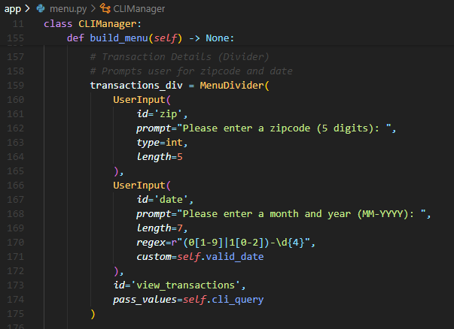
Command Line Interface
cli.py - Utility
menu.py - Component
General-Purpose
CLI Tool-Box
Simple
Application-Specific
User-friendly
Intuitive

Slide 13
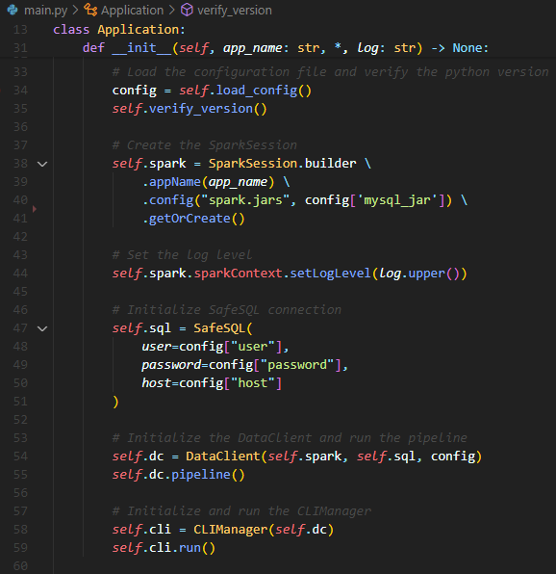
Application
Manager
main.py - Application
Loads Configurations
Initializes and Configures SparkSession (Connection to PySpark)
Creates SafeSQL Connection (Database Connector Utility)
Instantiates Data Client and runs ETL Pipeline
Instantiates and runs CLIManager

Slide 14
Project Structure
main.py # Application requirements.txt # Required Libraries app/ ├── data_client.py # Data Client ├── menu.py # CLI Menu Class └── transformers.py # Transformer Functions config/ ├── config.json # PySpark, MySQL Config └── constants.py # Global Constants data/ # JSON files ├── cdw_sapp_branch.json ├── cdw_sapp_credit_card.json └── cdw_sapp_customer.json | lib/ # MySQL Connector JDBC └── mysql-connector-j-9.3.0.jar sql/ # SQL Scripts ├── cli_script.sql └── init.sql utils/ ├── cli.py # CLI Builder Class └── sql.py # MySQL Connector Class docs/ ├── CAP350_Project_Specs.pdf ├── diagrams/ # Workflow Diagrams └── mapping/ # Mapping PDFs

Slide 15
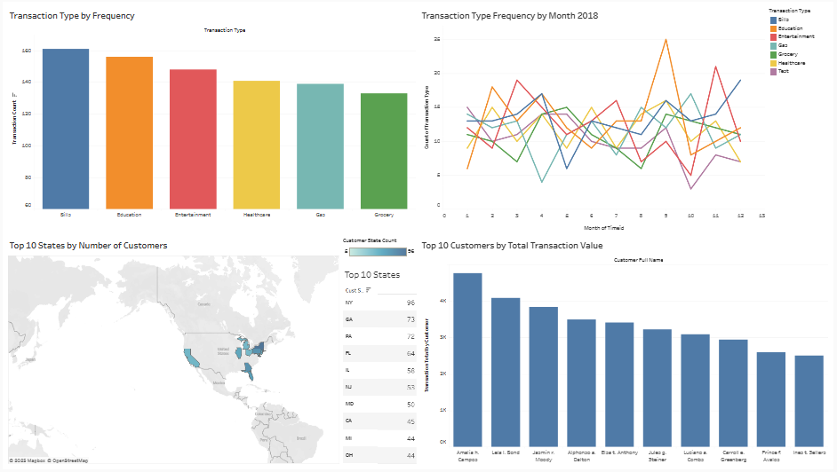
Tableau Visualization
Notes:
Tableau Public Viz Link: https://public.tableau.com/views/CustomerDataDashboard_17484417707510/CustomerDataDashboard?:language=en-US&:sid=&:redirect=auth&:display_count=n&:origin=viz_share_link

Slide 16




Thank you for your time!
github.com/kencopas/Capstone
Kenny Copas
Jr. Data Engineer
PeopleShores PBC
Tampa, FL
linkedin.com/in/kennycopas

